Slide 1

Northeastern University
Database Design for Cellular Company: Team Fantastic Mobile
INFO6210 18748 Data Mgt & Database Design
SEC 09 - Fall 2016
Guide: Prof. Vincent Lattuada
Members:
Shantam Gupta
Vaishali Lambe
Yuxin Zhang
Zhiyi Wang

Slide 2
Introduction
The Database Model for Fantastic Mobile is a representation of a small scale Cellular Company database model.
This model contains information about the services provided by the company with a special focus of the tracking mechanism to regulate the services.

Slide 3
Software Used
Below software are used as part of this project:
Toad Data Modeler
Microsoft SQL Server Management Studio
MySQL
WAMP
R

Slide 4
Business Requirements
Fantastic Mobile Company provides following products and services :
Contract (Service)
Phone (Product)
SIM Card (Product)
Mechanism to track Voice/Text/Data services

Slide 5
High Level Image

Slide 6
Additional Scopes
Sr. No. | Description
AS01 | A phone device could change towers for signal transmission.
AS02 | Each tower can receive and transmit multiple signals from innumerous devices within its specified range.
AS03 | Customer is not bound to purchase a contract, a SIM card and a phone from the company

Slide 7
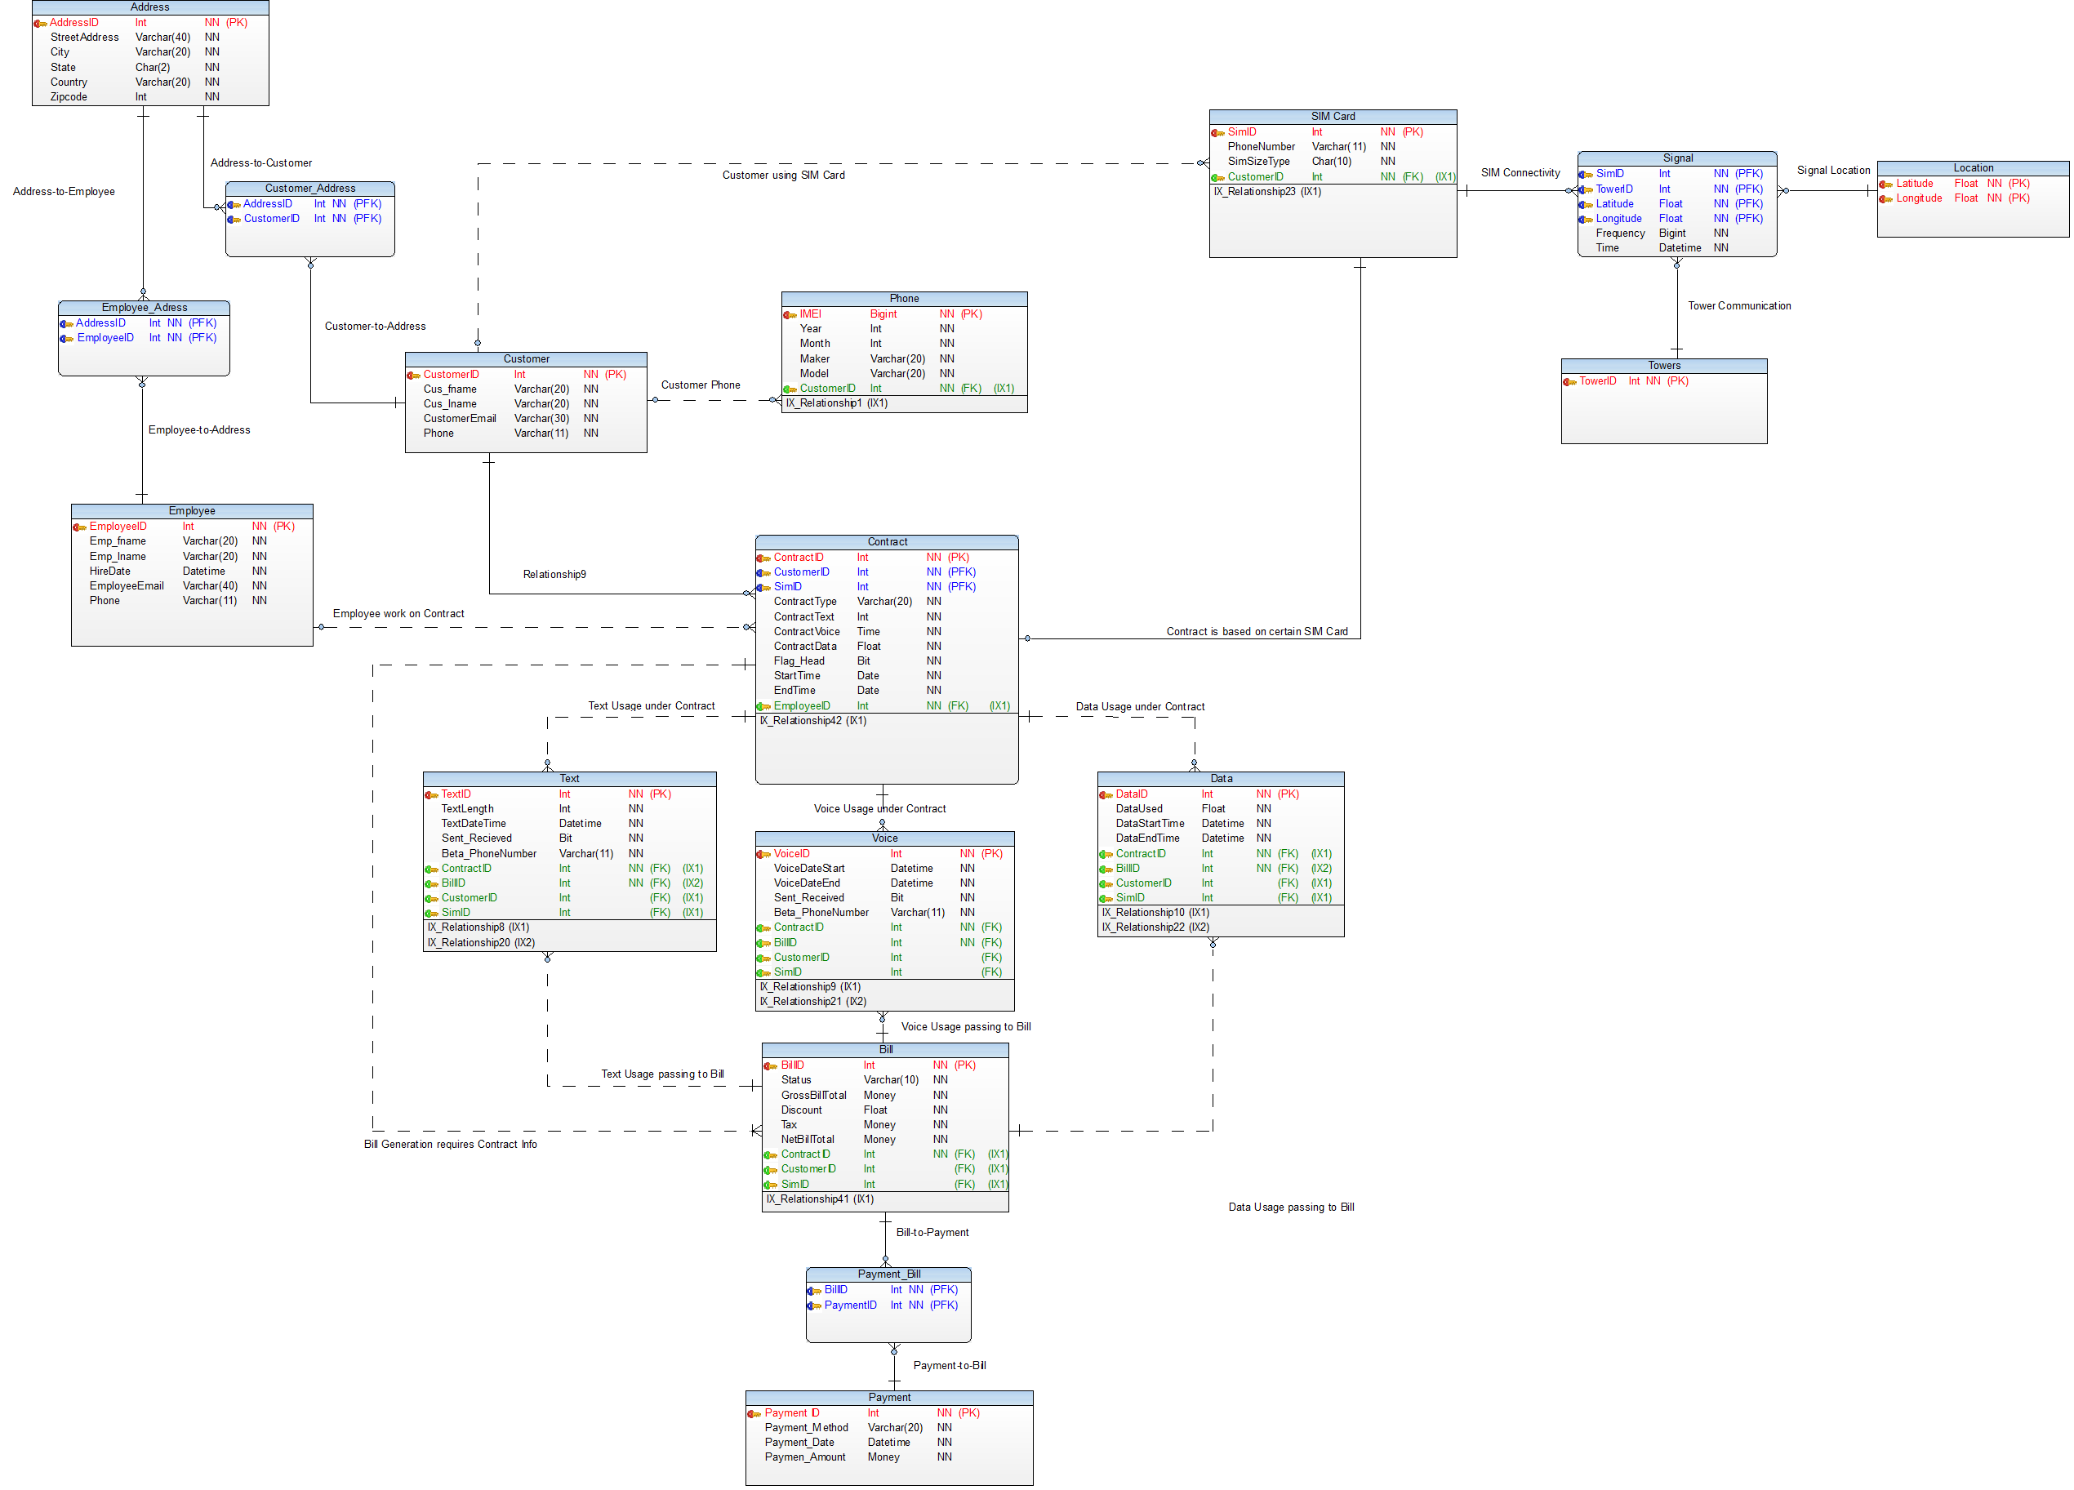
Database Design Image

Slide 8
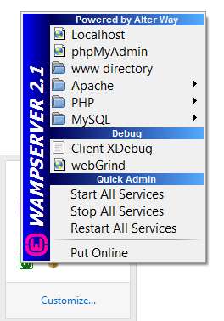
PHP-MySQL Integration using WAMP
Install Wamp server
Restart All services
Connect to phpMyAdmin
Create database table
Establish connection
<?php $con = mysql_connect('localhost','root','');
if (!$con){ die('Could not connect: ' . mysql_error()); }
mysql_select_db("customer_db", $con);?>
Type localhost/*.php (specific php file) in browser

Slide 9
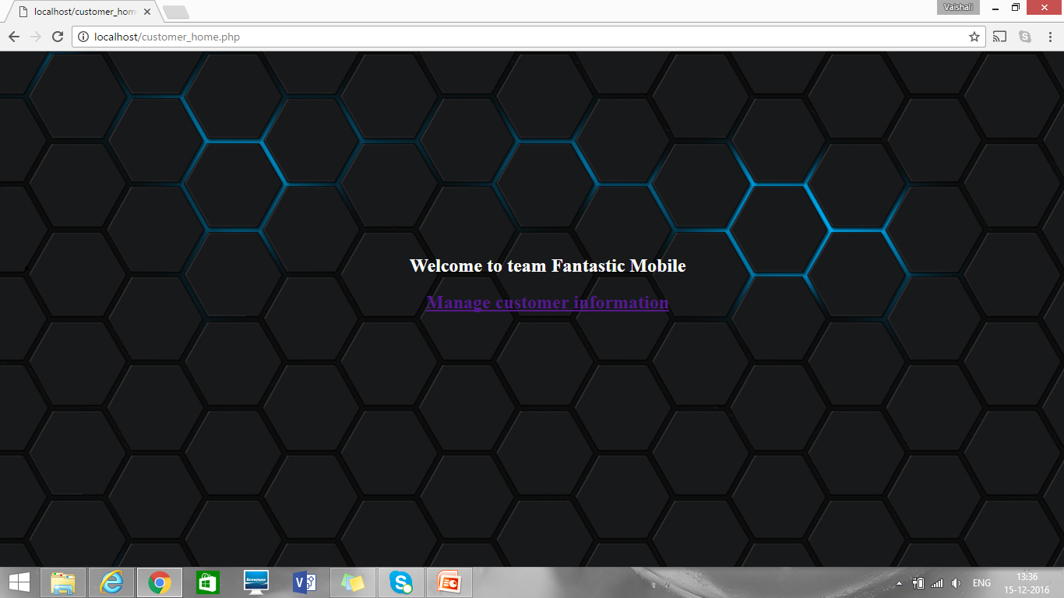
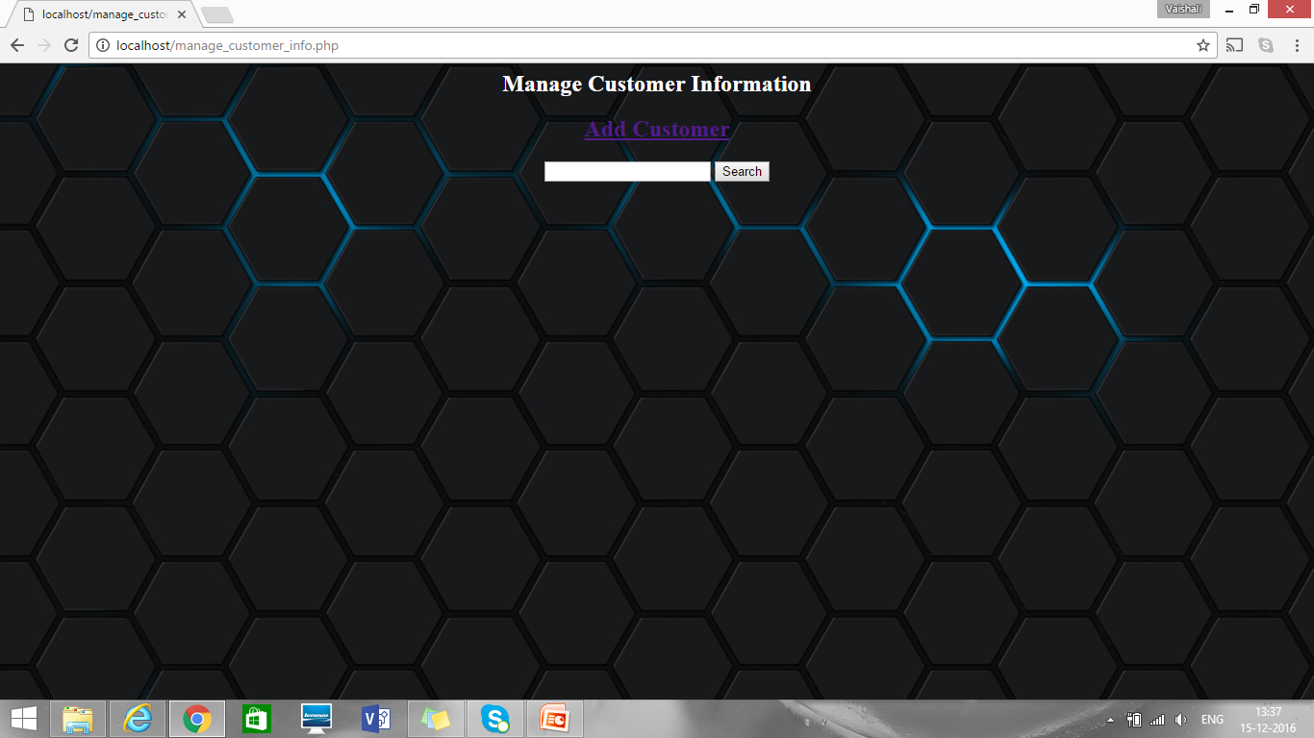
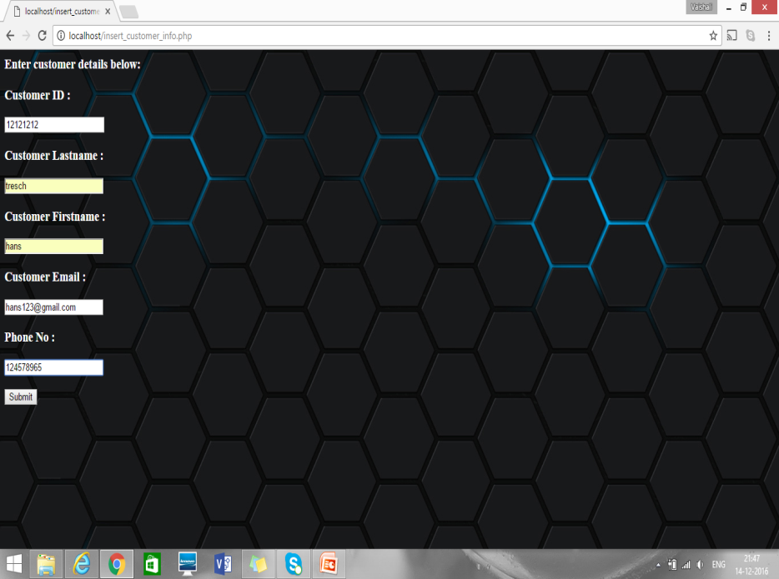
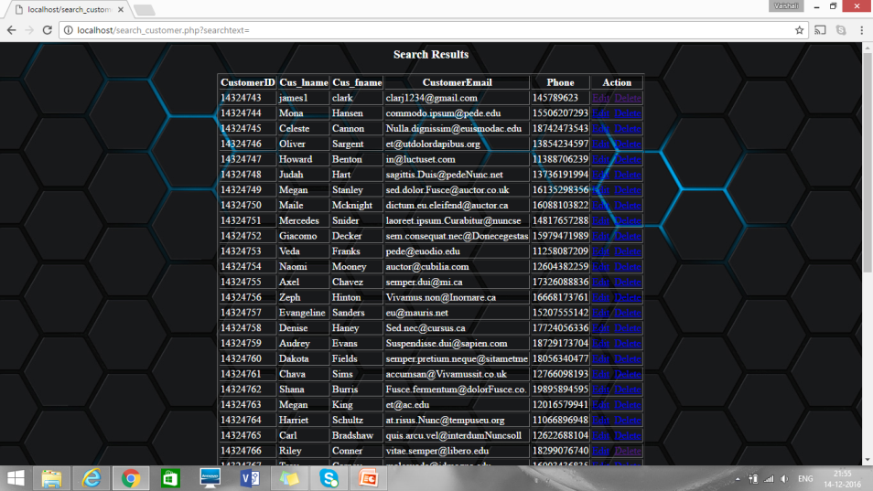
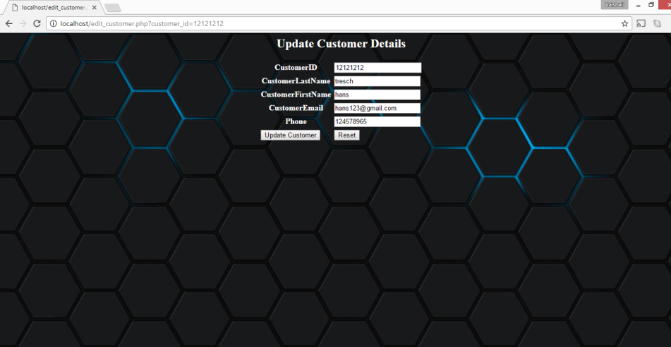
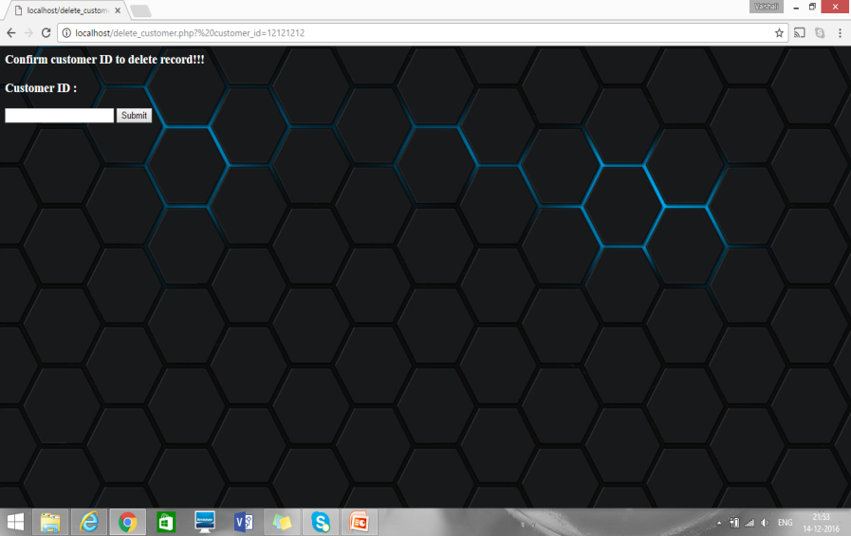

Slide 10
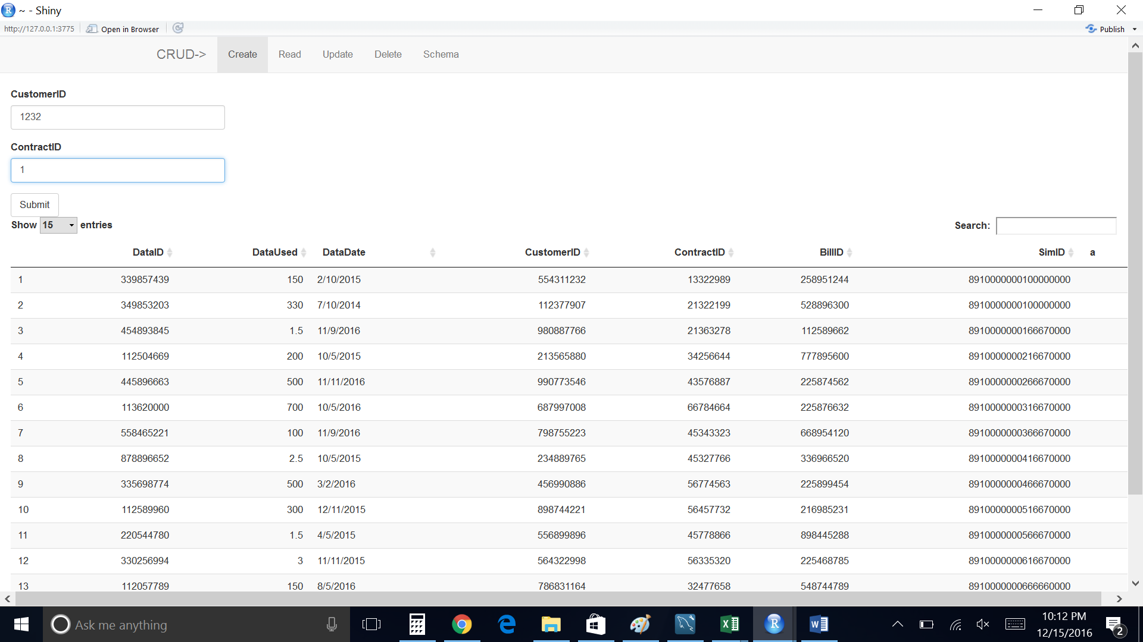
Rshiny MySQL Integration
Some packages used in R
Rshiny
RMySQL
DT

Slide 11
Q & A
Feel free to ask your questions

